Slide 1
Fit5136 Assignment1 Presentation
Team 36

Slide 2
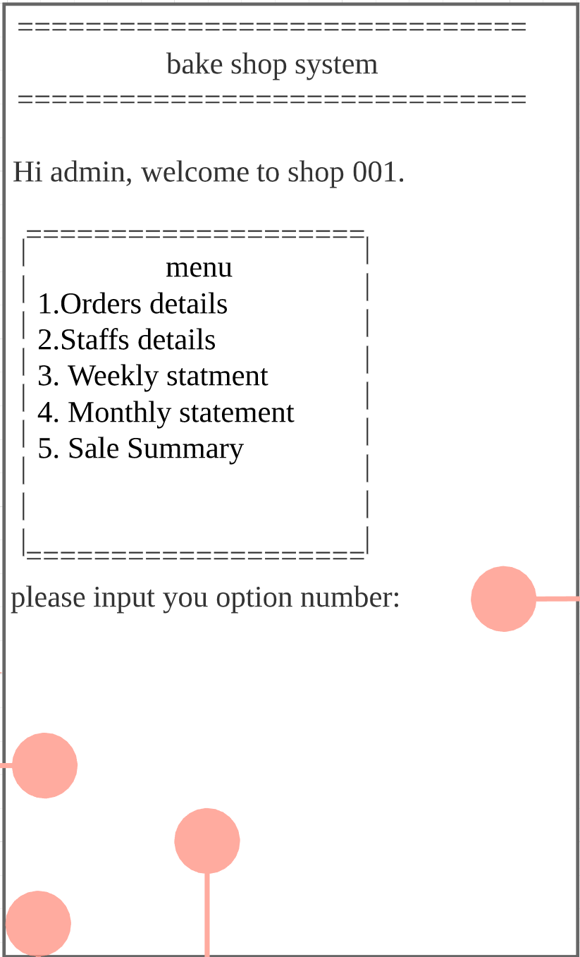
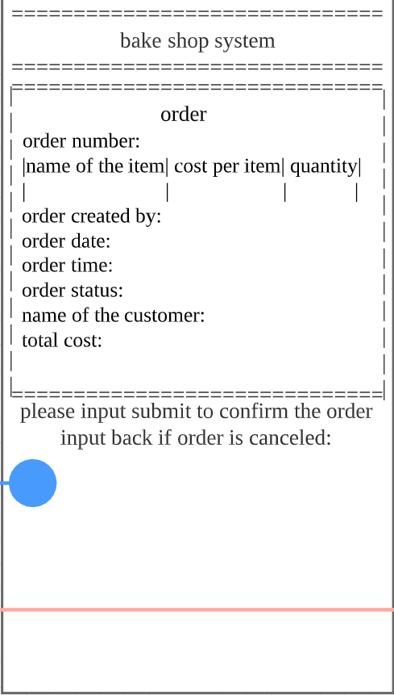
Part 1 UX design
Heading(placeholder)
Executing Window(input inside and automatic generated)
Command line(The line used to jump to another interface)

Slide 3
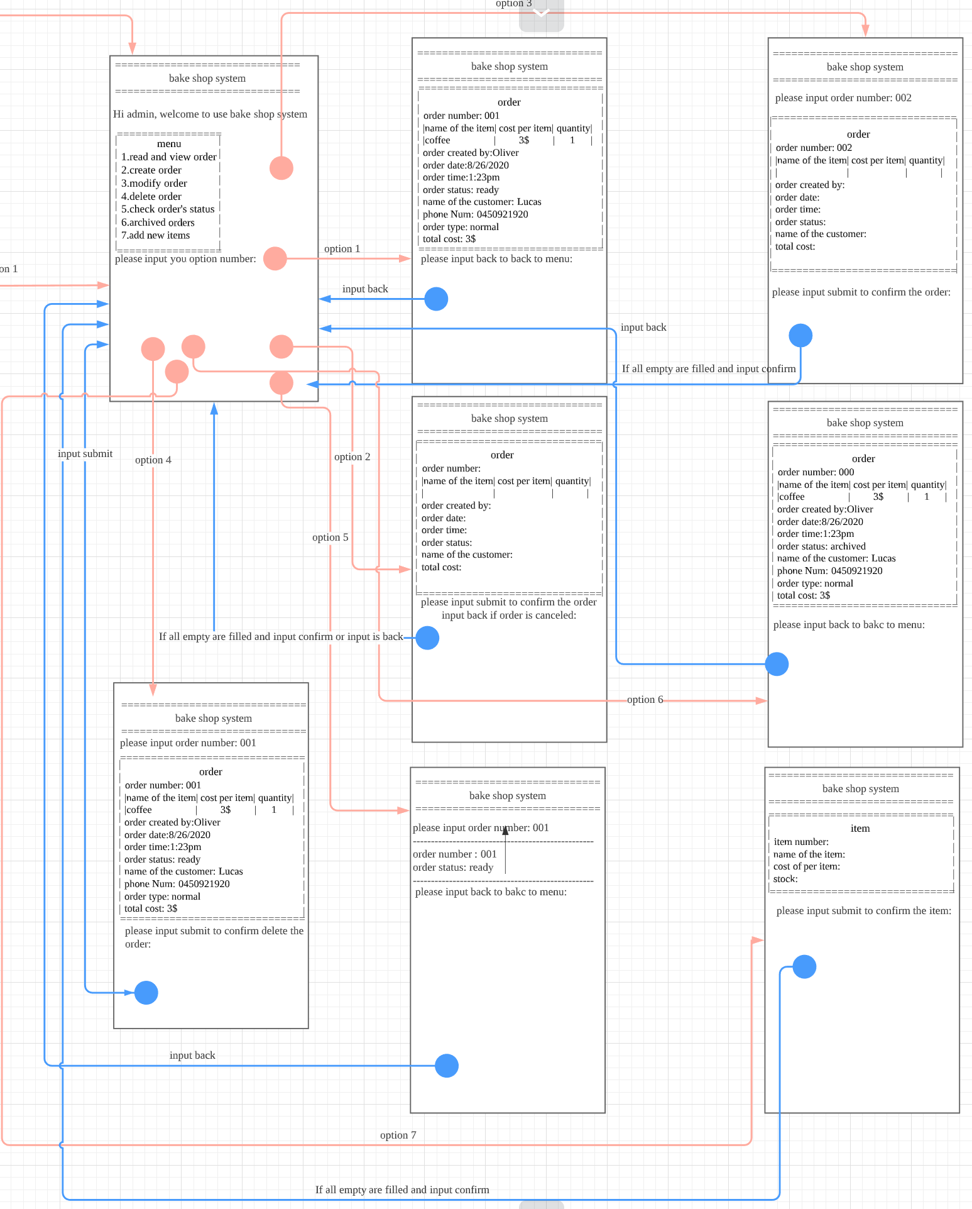
Part 2 Flow of events
Order System:
Red arrow is going forward.
Blue arrow is going back to main menu
A simple one-way designed is used in the order system

Slide 4
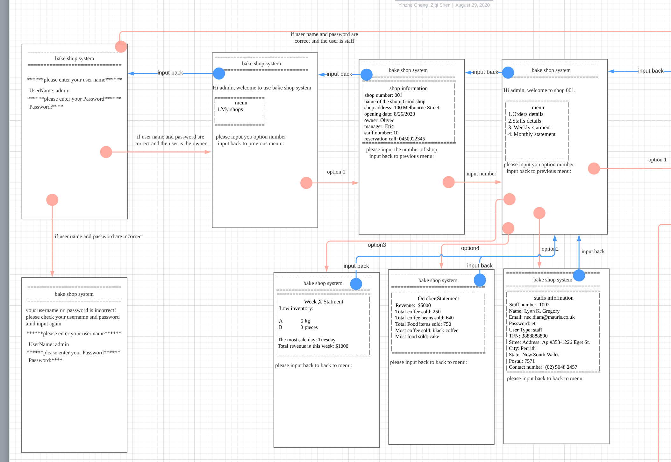
Part 2 Flow of events
Login in and Statement system
Red arrow is going forward.
Blue arrow is going back to main menu

Slide 5
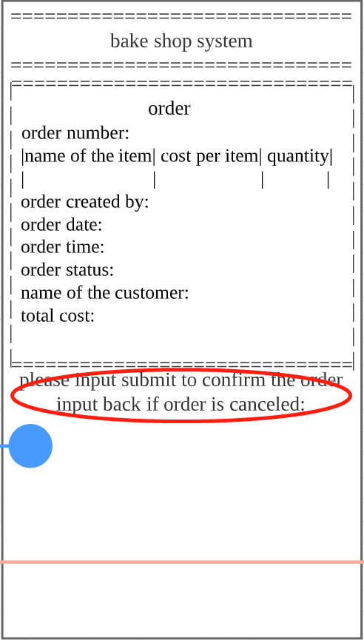
Part 3 Principles
Cognitive aids and Constraints
Constraints: The places of input is controlled and some of the inputs will be automatically filled
Cognitive aids: In each menu, ways to confirm and go back is clearly indicated in the interface

